Slide 1
Communication
Raw message passing
TCP/IP: reliable byte stream
UDP/IP: unreliable, packet oriented, connectionless
Problem: low level --> not easy to use

Slide 2
RPC Architecture
Caller
Callee
Caller
procedure
Caller
stub
Comm.
Comm.
Callee
stub
Callee
procedure
Marshall
params
Call packet(s)
Unmarshall
arguments
Call(…)
Transmit
Receive
Call
.
.
.
Unmarshall
results
Result packet(s)
Transmit
Marshall
results
Receive
Return

Slide 3

WatDFS
Projects 1 & 2
CS 454/654

Slide 4
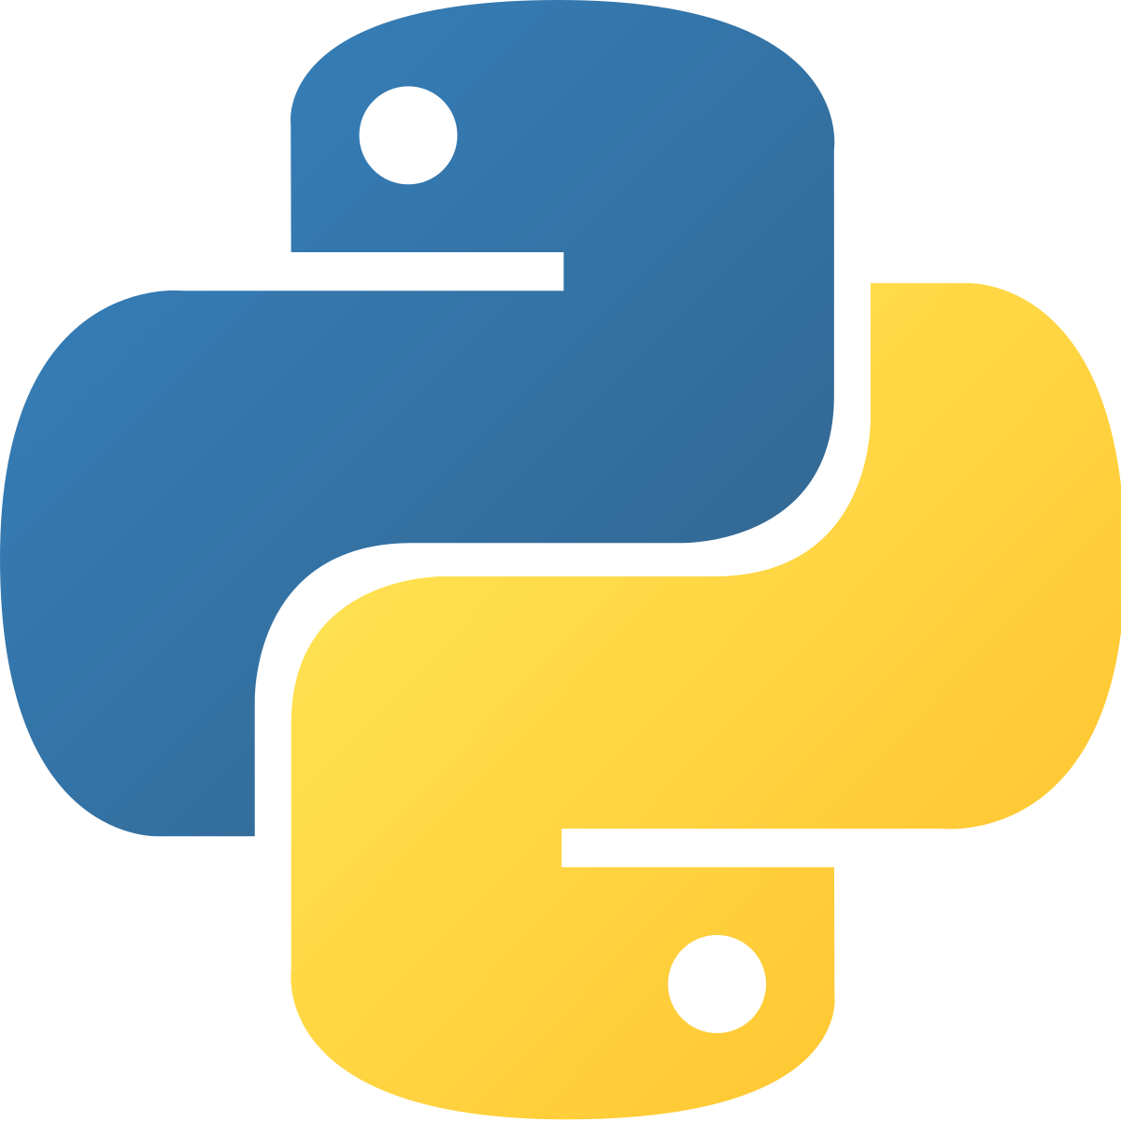



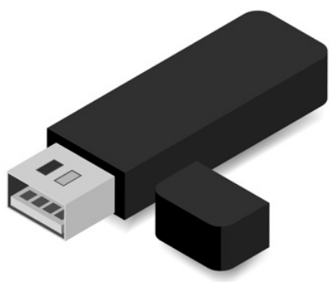

File System Operations
System
Applications
f = open(‘/home/file.txt’)
print(len(f.readlines()))
$ cat ‘/home/file.txt’
Notes:
WatDFS is a distributed file system. Before we talk about the distributed part, let’s first discuss file system operations, which constitutes the core functionality of WatDFS.
Think about how we store and retrieve data on our computing devices (your laptop, mobile, or linux.student.cs servers). On one end, all data is ultimately stored as binary bits on a physical device, such as a Hard Disk Drive (HDD) or a USB drive shown in the figure.
On the other end, we have a variety of applications that want to access the physically stored data. Some example applications are shown in the figure, such as your file explorer (listing and opening files using a GUI), a terminal (list and open files using command line applications such as `cat` and `ls`), and custom programs written in a specific programming language (such as Java or Python). Note that WatDFS is also one such custom application written in C++ that you need to build in this Project. The shared goal of all these applications is to be able to read and write data stored on the aforementioned physical devices shown at the bottom of the figure.
On the left, we show two examples of how file system operations are typically done in Python and the Bash terminal shell, respectively. Programming languages usually have specifically defined APIs that enable file system operations, usually called I/O operations. The example above shows how a file is first referenced using the `open()` method in Python and then the contents of the file are read using the `readlines` method. Similar techniques are available in other languages such as Java and C++. When implementing WatDFS, you’ll need to learn how I/O operations are done in C++.
Now a question arises. How does `open()` or `cat` know where `/home/file.txt` exists? And how is the data actually retrieved from the HDD or USB drive to these variety of applications?

Slide 5
File System Operations
System
Applications
f = open(‘/home/file.txt’)
print(len(f.readlines()))
user space
$ cat ‘/home/file.txt’
kernel space
Notes:
The answer is of course that the underlying Operating System (Linux in WatDFS’ case) is responsible for handling all I/O requests from applications, forwarding those requests to the physical storage devices, and sending back the results.
Note the division between the user space and kernel space. Applications generally run in the user space where they cannot interfere with the OS operations and an application crash in the user space will not affect the OS. On the other hand, OS operations such as file I/O are done in the kernel space, but one needs to be more careful as a crash in the kernel space can bring the whole OS down. This important point will be relevant soon in the upcoming slides.

Slide 6
File System Operations
System
Applications
f = open(‘/home/file.txt’)
print(len(f.readlines()))
user space
$ cat ‘/home/file.txt’
kernel space
open(‘/home/file.txt’)
Virtual File System
Notes:
All I/O operations coming from different applications are internally translated into a common set of `system calls` that the OS understands. For example, the `open()` call from the Python and the `cat` command above both translate into an `open` system call on Linux. Note that the `open()` on the left is a Python method and is very different from the `open()` system call on the right, which is a C/C++ function available in the glibc library. In WatDFS, you’ll be working with a number of such system calls.
As shown, the Virtual File System (VFS) component of the Linux OS is responsible for handling the file I/O system calls. The next question is: how does the VFS module know whether `/home/file.txt` exists on the HDD or the USB drive?

Slide 7
File System Operations
System
Applications
f = open(‘/home/file.txt’)
print(len(f.readlines()))
user space
$ cat ‘/home/file.txt’
kernel space
open(‘/home/file.txt’)
Virtual File System
ntfs
ext4
/media
/
Notes:
The VFS module uses the full file path to determine where to look for the files.
As shown, the HDD is “mounted” at `/` (this is the root path for all files) while the USB drive is mounted at `/media`. The mount paths are determined by the system administrator.
In the figure, the mount paths indicate that file paths starting with `/media` (e.g., `/media/songs/fav.mp3`) should all be processed by the USB drive, while the rest of the paths exist on the HDD. This feature will come in handy shortly in the upcoming slides.
To summarize, on a single system:
* A variety of applications all expose different ways to perform file I/O operations.
* All such I/O requests are internally converted using libraries to appropriate system calls that the OS understand.
* The OS VFS module intercepts the I/O requests and delegates them to the proper hardware device based on the file paths.

Slide 8
File System Operations
System
stat
open, mknod
pread, pwrite
fsync
utimensat
Applications
user space
kernel space
open(‘/home/file.txt’)
Virtual File System
ntfs
ext4
/media
/
Notes:
This slide notes all the Linux system calls you’ll have to learn about and understand how they work while working on WatDFS. The spec has links to all the man pages which you should read thoroughly at least once, and then frequently refer back to when writing your code.

Slide 9
Distributed File System
Client
Client
Server
Applications
?
user space
kernel space
Client
Virtual File System
ntfs
ext4
/media
/
Notes:
Now we come to the second component of WatDFS that makes it a distributed file system. As the figure shows, instead of having a single system containing both the storage devices and the applications accessing data from the storage, we want the ability to have two kinds of systems, one which is responsible for storing the data (the server on the right) and the other for running the applications (one or more clients on the left). An example could be a Python program running on your laptop that want to access all files stored on the linux.student.cs servers.
Broadly, this will need the ability for the applications running on a client server to be able to do remote file I/O operations over the network. To achieve this goal, we need to make some changes to both the server and the client...

Slide 10
Distributed File System
Client
Client
Server
Applications
?
Server Module
user space
kernel space
open(‘/home/file.txt’)
Client
Virtual File System
ntfs
ext4
/media
/
Notes:
On the server side, a “server module” will be responsible for accepting file I/O requests from the clients and translating them to appropriate system calls that can then be normally handled by the OS as in a single system setting.
Note that green in the figures indicate components whose code you’ll have to implement as part of the WatDFS Project.

Slide 11
Distributed File System
Client
Client
Server
Applications
?
Server Module
user space
Modified to directly access server?
kernel space
open(‘/home/file.txt’)
Client
Virtual File System
from rlib import ropen
f = ropen(‘<ip>/file.txt’)
print(len(f.readlines()))
ntfs
ext4
/media
/
Notes:
On the client side, what can we do?
One idea is to modify the applications directly. On the left, we show an example where the earlier Python program is modified to use a hypothetical `ropen` method that can communicate to the server directly using the server’s IP address. SImilar modifications can be done to `cat` or the file explorer from our examples.
Modifying the code would work. However, do we want to do this?

Slide 12
Distributed File System
Client
Applications
Applications should be provided with access transparency.
Notes:
It’d not be ideal to have to go modify the code for all the applications that want to use a distributed file system. Apart from the effort in doing so, one would have to maintain 2 code paths, for dealing with direct file I/O and remote file I/O.
What we want instead is “access transparency”, which means the applications should continue functioning the same way with the same code irrespective of whether the files are present on the same system or a remote one. How can we achieve this?

Slide 13
Distributed File System
Client
Applications
Applications should be provided with access transparency.
user space
open(‘/remote/file.txt’)
kernel space
Interaction with the local file system remains unchanged.
Virtual File System
Notes:
Instead of changing the applications directly, we can change the virtual file system module in the OS to handle both direct file I/O on the same system (as is already the case) and also remote I/O. How will this work?

Slide 14
Distributed File System
Client
Applications
user space
open(‘/remote/file.txt’)
kernel space
/remote
ropen(‘<ip>/file.txt’)
To server
Virtual File System
Client Module
Client module performs remote access on behalf of application.
/
ext4
Notes:
We’ll use the path-based mounting system we described earlier to enable the direct+remote I/O functionality.
As shown, we can mount a special path (`/remote` in the example) which will be handled by a custom client module written by us that sends any incoming file I/O to the remote server. All file operations not starting with `/remote` will be handled normally by the local file system.
So we have a working design to implement a transparent distributed file system. Applications that need to access local files will perform use `/` paths as before, while for remote I/O, they will need to use the `/remote` paths. Everything else remains the same.
But this design still has a weak point. What is it?

Slide 15
Distributed File System
Client
Does the client module need to be in kernel space?
Applications
user space
open(‘/remote/file.txt’)
kernel space
/remote
ropen(‘<ip>/file.txt’)
To server
Virtual File System
Client Module
/
ext4
Notes:
Remember what we discussed about the user space vs the kernel space. Because the client module code is the kernel space, any bug or crash could affect the stability and security of the OS itself. We especially don’t want to run arbitrary code written by students when testing the code on Marmoset.
So what can we do?

Slide 16
Distributed File System
Client
Does the client module need to be in kernel space?
Applications
user space
No! Use FUSE.
FUSE helps build a file system without writing kernel code.
open(‘/remote/file.txt’)
kernel space
Virtual File System
/remote
Client Module
/
ext4
Notes:
The client module needs to be in user space, where bugs or crashes will not be able to affect the OS. We do this by using an already available library called FUSE that is built exactly for building custom file systems such as WatDFS.

Slide 17
Distributed File System
Client
Applications
Client Module
ropen(‘<ip>/file.txt’)
To server
libfuse
user space
open(‘/remote/file.txt’)
kernel space
Virtual File System
/remote
FUSE Kernel Module
/
ext4
Notes:
FUSE already provided a well tested kernel module that accepts the file I/O operations and sends them back to code running in user space, which then handles those operations.
Thus, we write our Client module in user space that performs the remote I/O calls.
To summarize:
* Applications will perform the same I/O calls as before (but will have to use the correct path if they want to perform remote I/O calls).
* A new path is mounted using FUSE that tells the VFS to redirect all remote file I/O operations to the FUSE kernel module.
* The FUSE kernel module simply forwards the operations to the userspace module.
* The userspace code (written as part of the Project) will translate the I/O operations into remote calls to the server and handle the responses.

Slide 18
Client & Server Communication
Client
Server
Applications
Client Module
?
Server Module
libfuse
user space
user space
kernel space
open(‘/home/file.txt’)
open(‘/remote/file.txt’)
kernel space
/remote
Virtual File System
Virtual File System
FUSE Kernel Module
/
ntfs
ext4
ext4
/media
/
Notes:
The next and final design question is: how do the client and server modules communicate with each other? We need a common communication protocol that both the modules understand.
There are a variety of techniques we can use. A few examples are HTTP, SOAP, and Telnet (look these up if you’re not familiar with any of these fascinating protocols). Any of these will work. We describe the protocol used in WatDFS in the next slide.

Slide 19
Client & Server Communication
Client
Server
Remote Procedure Call
Applications
libfuse handler
RPC
calls
RPC Listener
Request Handler
libfuse
user space
user space
kernel space
open(‘/home/file.txt’)
open(‘/remote/file.txt’)
kernel space
/remote
Virtual File System
Virtual File System
FUSE Kernel Module
/
ntfs
ext4
ext4
/media
/
Notes:
For WatDFS, we chose to use a custom Remote Procedure Call (RPC) protocol implemented in C++. Both the client and server module have RPC-specific code that allows the client and the server to exchange file I/O operations and their results.
The spec and the example code shows how this RPC looks like and how to use it. We’ll also walk through the steps in the upcoming slides.

Slide 20
Project 1
Goal: Implement WatDFS - a distributed file system.
How: Implement the WatDFS client and server modules.
4 parts
Notes:
We will next describe the 4 key components you’ll have to implement as part of the WatDFS Project 2.

Slide 21
Project 1
Client
Server
2
3
Remote Procedure Call
Applications
libfuse handler
RPC
calls
RPC Listener
Request Handler
1
4
libfuse
user space
user space
kernel space
getattr(‘/home/file.txt’)
getattr(‘/remote/file.txt’)
kernel space
/remote
Virtual File System
Virtual File System
FUSE Kernel Module
/
ntfs
ext4
ext4
/media
/
Notes:
The 4 components are labelled in the figure. We’ll walk through them one by one next.
Do note the symmetry between the `getattr` system call made by the application on the extreme left and the system call made by the server request handler on the extreme right. This will be the same for all system calls in A2. Keep this diagram in mind when implementing A1 and especially when debugging your code as it will help you understand what to expect at different sections of your code vs what your logs are actually showing.

Slide 22
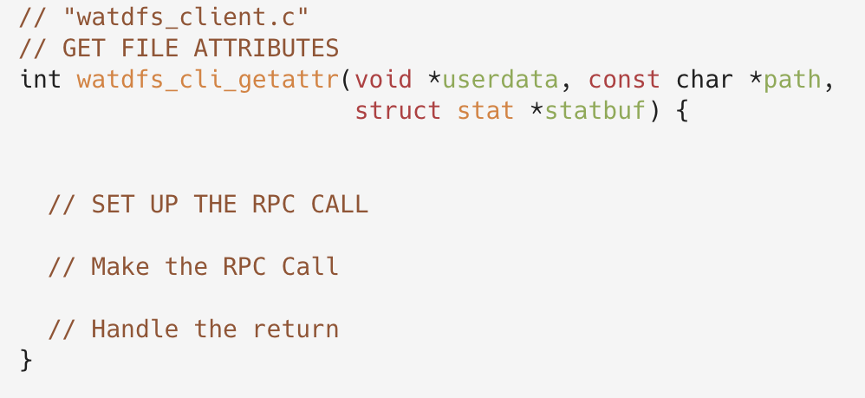
Project 1
Client
Server
2
3
Remote Procedure Call
Applications
libfuse handler
RPC
calls
RPC Listener
Request Handler
1
4
libfuse
user space
user space
kernel space
open(‘/home/file.txt’)
getattr(‘/remote/file.txt’)
kernel space
/remote
Virtual File System
Virtual File System
FUSE Kernel Module
/
ntfs
ext4
ext4
/media
/
Notes:
The first component is the client module that handles the file I/O operations coming from the FUSE kernel module (indirectly from the applications, one of which is Marmoset). We have designed WatDFS such that a specific set of I/O system calls <SC> (listed in a previous slide) in Linux are translated to watdfs_cli_<SC>.
The figure shows the example of a `getattr` system call which is used to get file attributes (or properties, such as size or modified timestamp). Everytime an application makes a remote `getattr` call (using the `/remote` path), the watdfs_cli_getattr function in WatDFS is called by FUSE. Similarly for the other system calls. Your task to finish implementing these different watdfs_cli_* functions.

Slide 23
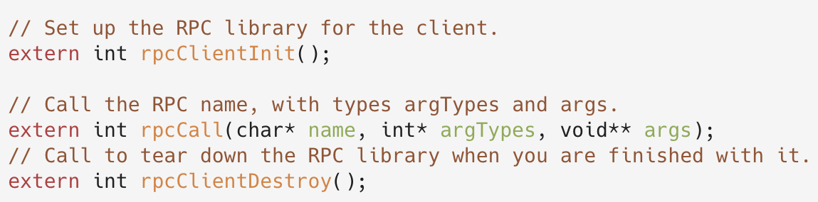
Project 1
Client
Server
Remote Procedure Call
Applications
libfuse handler
RPC
calls
RPC Listener
Request Handler
2
libfuse
user space
user space
kernel space
open(‘/home/file.txt’)
getattr(‘/remote/file.txt’)
kernel space
/remote
Virtual File System
Virtual File System
FUSE Kernel Module
/
ntfs
ext4
ext4
/media
/
Notes:
The second component is the RPC library that the client module uses to send the I/O operations to the server. The key function is the `rpcCall`. We will show how this is used in upcoming slides.

Slide 24
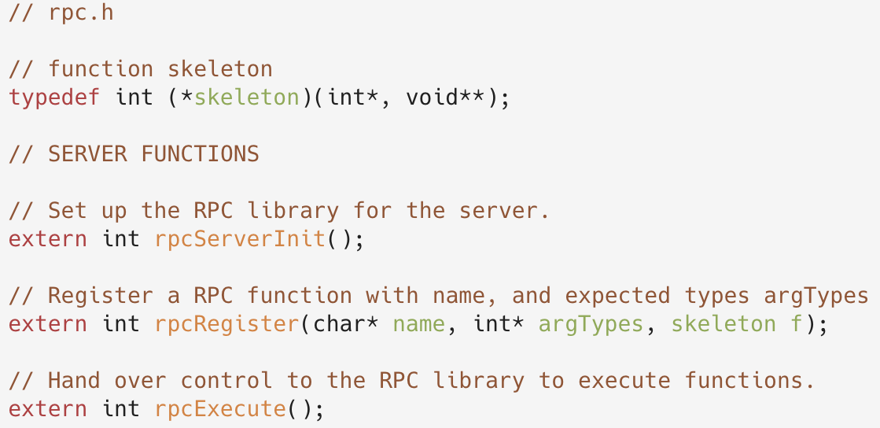
Project 1
Client
Server
3
Remote Procedure Call
Applications
libfuse handler
RPC
calls
RPC Listener
Request Handler
1
libfuse
user space
user space
kernel space
getattr(‘/home/file.txt’)
open(‘/remote/file.txt’)
kernel space
/remote
Virtual File System
Virtual File System
FUSE Kernel Module
/
ntfs
ext4
ext4
/media
/
Notes:
The third component is the RPC library on the server side. You’ll need to define a set of valid RPC calls that the server can accept using `rpcRegister` and indicate what code to execute for each such remote call.

Slide 25
Project 1
Creating, opening and closing a file
mknod, open, release
Retrieving file attributes
getattr
Reading and writing data
pread, pwrite
Truncating and synchronizing file
truncate, fsync
Changing file metadata
utimensat
Client
Server
2
3
Remote Procedure Call
Applications
libfuse handler
RPC
calls
RPC Listener
Request Handler
libfuse
4
user space
user space
kernel space
getattr(‘/home/file.txt’)
getattr(‘/remote/file.txt’)
kernel space
/remote
Virtual File System
Virtual File System
FUSE Kernel Module
/
ntfs
ext4
ext4
/media
/
Notes:
The fourth and final component is the code that makes the actual system calls on the server for every incoming I/O operation.

Slide 26
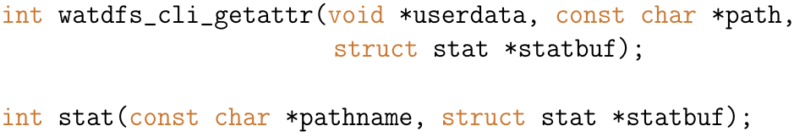
Implementation walkthrough
Goal: get file attributes
Type | Member Name | Description
mode_t | st_mode | Mode of file (Read, write permissions)
off_t | st_size | File size in bytes
time_t | st_mtime | Time of last data modification
… | … | More fields
Notes:
Now let’s take a step by step look at how the code will need to be structured. We’ll continue to use the `getattr` system call as our example.
Above, we show the `watdfs_cli_getattr` method to be implemented in the client module and corresponding the `stat` system call of Linux that needs to be executed on the server module.
The `stat` system call writes its output to the statbuf parameter. To understand this structure, you’ll need to look at the man pages which show the internal variables of the struct. We have listed some of the important ones above.

Slide 27
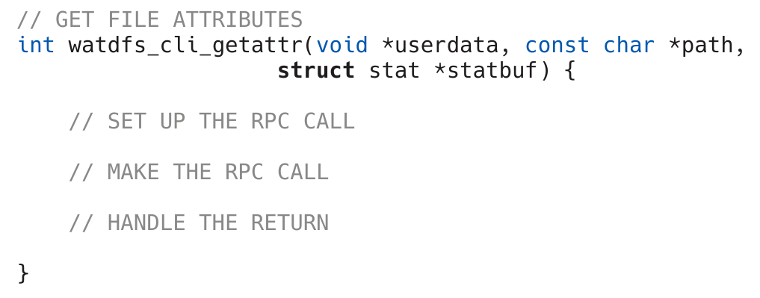
1) libFUSE handler: watdfs_cli_gettatr
1
Notes:
Back to the first component in our architecture. Each of the watdfs_cli_* functions will have the same implementation steps:
1) Use the function parameters to setup the RPC call you want to make to the server.
2) Make the RPC call using `rpcCall`.
3) Process the output you got from the rpcCall. It is very important you write the correct error handling code. Finally, return the correct response from the function.
We’ll discuss how to do these steps in the following slides.

Slide 28
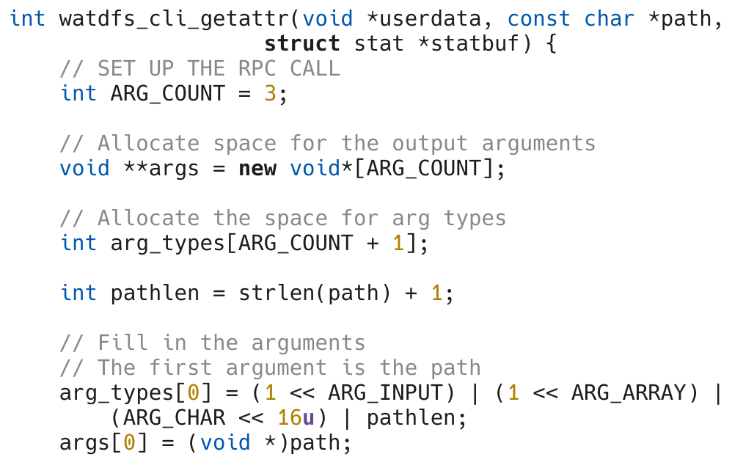
2) watdfs_cli_gettatr: Setting up a RPC Call
2
.
.
.
Notes:
The RPC library has a very specific way of setting up the remote call:
First, allocate the appropriate amount of space to store all the arguments of the remote call (`args` above). For `getattr`, we will need to send 3 arguments: the file path (char array), the statbuf structure (binary array), and a return code (int, to indicate success or failure) (all described in Section 4 of the spec). Note that the RPC library accepts arguments in the form of `void *` pointers. It is important to provide the correct pointers.
Second, because the arguments all are of type `void *`, we will need another `arg_types` array that tells the RPC library the data type of the arguments you’re sending. And because there can be a variable number of arguments for different rpc calls, we always put an extra 0 as the last argument type to indicate the end of arguments. This is why the arg_types array’s length is 1 larger than ARG_COUNT.
(continued...)

Slide 29
2) watdfs_cli_gettatr: Setting up a RPC Call
2
1 0 1 x x x x x | 0 0 0 0 0 0 0 1 | 0 0 0 0 0 0 0 0 0 0 0 0 1 0 0 1
Notes:
Next is an important step: how to indicate the datatype of the 3 arguments. We use 4-byte `int`s for this purpose, where each byte has a special interpretation. The array at the bottom is showing the 4 bytes of arg_types[0] in binary form:
1) The first 3 bits of the first byte (101xxxxx) tells whether the argument is an input, needs to be returned as an output, and whether the argument is an array, respectively. The rest of the bits are currently ignored. In our example, the first argument is an input of type array. So we set the first and the third bit using bit operations `(1 << ARG_INPUT) | (1 << ARG_ARRAY)`. The ARG_INPUT and ARG_ARRAY constants are available in the `rpc.h` file in the provided code.
(continued...)

Slide 30
2) watdfs_cli_gettatr: Setting up a RPC Call
2
1 0 1 x x x x x | 0 0 0 0 0 0 0 1 | 0 0 0 0 0 0 0 0 0 0 0 0 1 0 0 1
Notes:
2) The second byte (00000001) tells the data type of the argument, which is char in this case. We set the second byte by bit shifting the value of ARG_CHAR (which is 1 as given in rpc.h) by 16 places.
(continued...)

Slide 31
2) watdfs_cli_gettatr: Setting up a RPC Call
2
1 0 1 x x x x x | 0 0 0 0 0 0 0 1 | 0 0 0 0 0 0 0 0 0 0 0 0 1 0 1 0
Notes:
3) If the argument is an array, the last 2 bytes are used to indicate the size of the array. If it’s not an array, the last 2 bytes are ignored. Above, the last 2 bytes are set by simply performing a bitwise OR of the length of the file path (`| pathlen` = 10 = 1010 for ‘/file.txt\0’) with the rest of the number. Note that pathlen is length of string + 1 to account for the `\0` at the end of C-style strings.
Thus we created arg_types[0]. We do the same for the remaining 2 arguments (next slide).
(continued...)

Slide 32
2) watdfs_cli_gettatr: Setting up a RPC Call
2
1 0 1 x x x x x | 0 0 0 0 0 0 0 1 | 0 0 0 0 0 0 0 0 0 0 0 0 1 0 0 1
Notes:
The final step is to set `args[0]` pointer to the correct argument. Here, `path` is first cast to `void *` (because all `args` are `void *` pointers) and then saved in `args[0]`.
If you are unfamiliar with bit operations, you should look them up to clearly understand how the full arg_type is being constructed above.
Important note: Because the length of the array is limited to 2 bytes, one RPC call can only send or receive up to 65535 bytes (MAX_ARRAY_LEN in rpc.h). To read or write files larger than MAX_ARRAY_LEN, you’ll have to make multiple rpc calls. Handling this use case is part of A1 and A2 for file reads and writes.

Slide 33
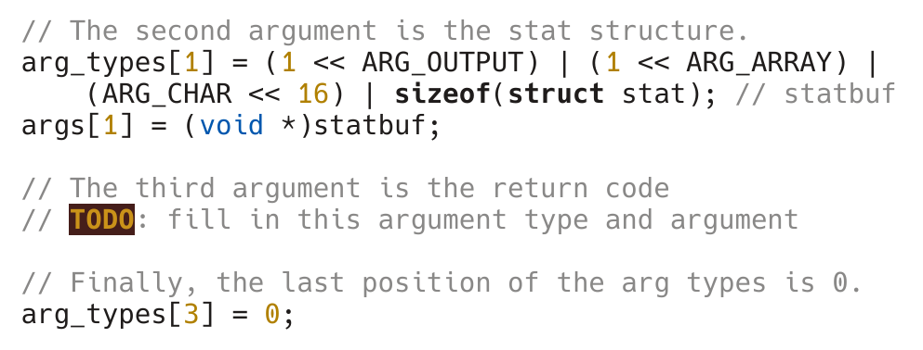
2) watdfs_cli_gettatr: Setting up a RPC Call
2
Notes:
The second argument in our example is the statbuf structure, which we treat as an output, because the `stat` system calls stores it’s output in this structure on the server and needs to be returned back to the client at the end of the RPC call. It is also a binary array as C++ structs can be treated as a sequence of binary bytes from the RPC library’s perspective. Note that in C++, binary arrays are represented by char arrays, hence this argument’s type becomes “output char array”. We thus set the arg_type using ARG_OUTPUT, ARG_ARRAY, and ARG_CHAR as shown above. The length of the array is the length of the statbuf struct, which is obtained by `sizeof(struct stat)`. args[1] is similarly set to statbuf.
The third argument is the return code, so an output of type int and no array. This is left as part of the Project.
Finally, the fourth `arg_types` is set to 0 to indicate end of arguments. Remember that there is no corresponding `args`.

Slide 34
2) watdfs_cli_gettatr: Making the RPC Call
2
Notes:
Once the `arg_types` and `args` are ready, you can make a `rpcCall`. The name of the call (“getattr” above) should match the string defined on the server (upcoming slides) and is something to check when debugging.

Slide 35
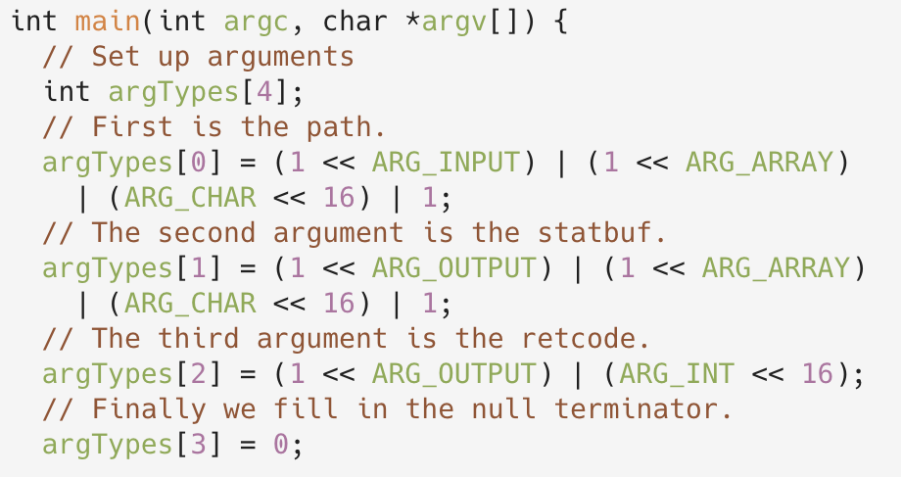
3) WatDFS Server: Setup RPC call
3
1 0 1 x x x x x | 0 0 0 0 0 0 0 1 | 0 0 0 0 0 0 0 0 0 0 0 0 0 0 0 1
Notes:
On the server, we have to define and “register” the corresponding “getattr” RPC call. We do this as shown above. Because this is a RPC definition and not a RPC call, there are some key differences than described on the client side.
1) There is no `args` variable, as that is only needed on the client when making a call.
2) If an argument is an array, the array size defined by the last 2 bytes is always set to 1, as shown for the first 2 arguments. This is because on the server side, we only know that the type is array but cannot know the size that a client might send. So we simply set it to 1.
The rest of the arg_type definition remains the same. When debugging, do check that these arg_types definitions match on the client and the server.

Slide 36
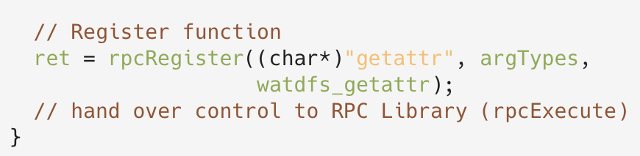
3) WatDFS Server: Register RPC call
3
Notes:
The rpcRegister is then used to “register” the RPC method (“getattr” in the above case) after which the method can be called remotely by the clients, as described on the slide for “Making the RPC Call”.
Note the `watdfs_getattr` argument above. This is used to indicate that whenever the server receives a remote RPC call called “getattr”, the watdfs_getattr method should be called to handle the request. This is defined in the next slide.

Slide 37
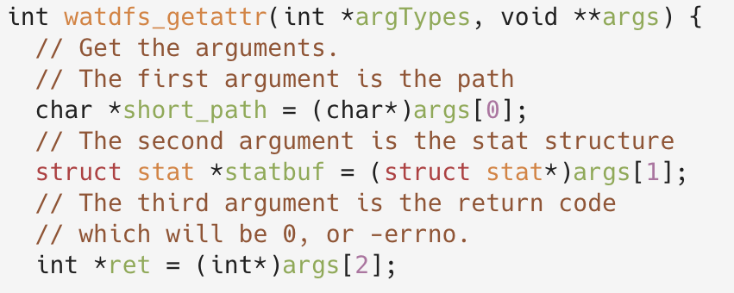
4) WatDFS Server: Define RPC function handler
4
Notes:
Finally, you’ll need to implement the actual method that performs the I/O operations on the server side. Above, this is the watdfs_getattr method.
The first step to decode the args that the client has sent by casting the `void *` type to the corresponding type, such as `char *`, `stat *` and `int *` for getattr as shown above.

Slide 38
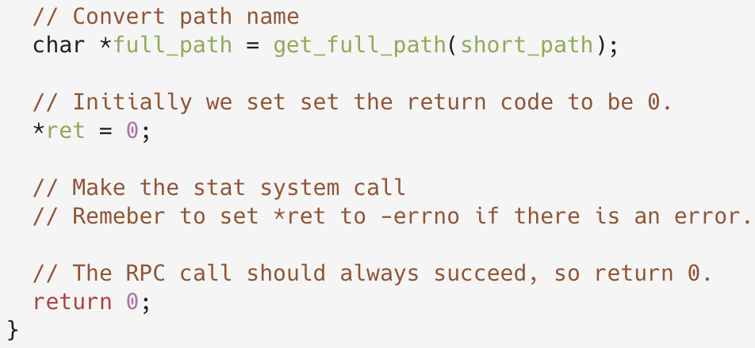
4) WatDFS Server: Define RPC function handler
4
Notes:
You’ll also need to convert the incoming path (which will look like /file.txt) to the appropriate full path that points to the files inside the server directory (such as /home/serverfiles/file.txt). We have given the `get_full_path` function implementation in the provided code.
Finally, you’ll need to perform the system call (`stat` in the above example), handle errors, and return the results.

Slide 39
Project 2
Make WatDFS more efficient.
Notes:
Now let’s talk about what you need to do in Project 2.

Slide 40
Project 1 Recap: Remote Access Model
Applications
WatDFS Client
WatDFS Server
Client
open(‘file.txt’, $mode)
open(‘file.txt’, $mode)
Virtual File System
file.txt
File stays on server
Notes:
To contrast with Project 1 first, we have the remote access model in A1. WatDFS intercepts file operations done by applications and sends those I/O operations directly to the server to be executed there. Thus, files always stay on the server. To perform any I/O operation, a remote call needs to be made to the server, as shown by the four solid arrows in the figure above.
This works, but is inefficient, as all file I/O needs to be executed over the network. We want to avoid excessive network communication where possible. The modifications in Project 2 is one possible way to achieve this, which we talk about next.

Slide 41
Project 2: Upload Download Model
Applications
WatDFS Client
WatDFS Server
Client
open(‘file.txt’, $mode)
Virtual File System
file.txt
(copy)
file.txt
File copied from server to client
Notes:
In Project 2, we change the design to an upload download model. Instead of performing all I/O operations on the server, there are now 2 components in WatDFS.
1) Upload download component: When an application want to perform some I/O operation on the file, WatDFS first downloads the file to a specified temporary location on the client. In other words, the files are cached on the client. If the application makes changes to the file, WatDFS also uploads those changes back to the server so that other clients can see those changes. These operations are shown using dotted lines in the figure.
2) Local access component: Applications’ I/O operations are then performed locally on the client machine on the file that WatDFS downloaded from the server. These operations are shown using solid lines in the figure.

Slide 42
Project 2: Mutual Exclusion on Client
Applications
WatDFS Client
WatDFS Server
Client
open(‘file.txt’, $mode)
Virtual File System
file.txt
(copy)
file.txt
Notes:
In Project 2, while applications can operate on multiple files at once, they cannot open the same file multiple times. In the above figure, say file.txt has already been opened by a Python application, then a second open() call by say a Java application (or even the same Python application) should be rejected by WatDFS with an error.
See Section 7.1.3 of the spec for more details.

Slide 43

Project 2: Mutual Exclusion on Server
Applications
WatDFS Client
WatDFS Server
Client 1
open(‘file.txt’, O_RDWR)
Virtual File System
file.txt
(copy)
file.txt
Applications
WatDFS Client
Applications
WatDFS Client
open(‘file.txt’, O_RDONLY)
open(‘file.txt’, O_WRONLY)
Client 2
Client 3
Notes:
In Project 2, there can be multiple clients that are performing I/O operations on the files stored at the WatDFS server. To ensure that all clients have a consistent view of the files, the server should not allow multiple clients to open the same file in the WRITE mode (O_WRONLY or O_RDWR).
Thus, multiple clients can open the same file in READ mode (O_RDONLY). But after a client has opened a file in WRITE mode (client 1 above), other clients are allowed to open the same file in READ mode (client 2 above) but not on WRITE mode (client 3 above) until the first client has closed the file.
Moreover, when clients 1 and 2 above are downloading from or uploading the file to WatDFS Server, they should not be allowed concurrently, otherwise clients might see corrupted file contents, where part of the file is old and part is new. To prevent this, WatDFS client should perform file transfers from and to the server atomically. by using remote locks, so that clients can fully transfer a file without interference from other clients.
See Section 7.1.2 and 7.1.4 of the spec for more details.

Slide 44
Project 2: Other Details
The implementation of the various calls in P2 need to follow some additional rules, specified in Section 7.1.6.
Handling of calls will depend on:
Whether the call is “read” call or a “write” call.
Whether the file is already open or not.
The exact details are specified in Section 7.1. We also outline a suggested implementation strategy in Section 7.2.
Notes:
There are some key challenges that will need to be handled in this new design, e.g., how to ensure the cached files are not stale and how file modifications are correctly made visible to all clients accessing the same file. The spec has full details on these design questions.
Project 2 will build up on the code written for A1. However, the code is definitely more complex as compared to A1 and will take much longer to write and debug.

Slide 45
Automated Testing using Marmoset
Applies to both P1 and P2.
There will be sets of public tests and release tests.
Your highest score across all submissions will be considered.
5 release tokens:
Use 1 token to see the output of 2 failing release tests.
Tokens renew every 24 hours.
Submission are graded even with 0 tokens, but cannot see test output.
Notes:
Marmoset is setup with 2 sets of test:
* All results (passed or failed) of the public tests will be shown each time you make a test submission.
* The results of the release tests will be hidden by default. To see the tests results and check the ones that are failing, you’ll need to use 1 release token out of 5 available that are renewed every 24 hours.
* The release tokens will only reveal the first 2 tests results that are failing. This is to prevent you from using Marmoset as your rapid testing framework. The goal is to let you check the failing tests and write local tests to replicate those errors and only submit to Marmoset after you’ve make your local tests pass.

Slide 46
Resources and Tips
Spec and provided code
Read the documentation and comments carefully.
Testing & debugging
Use command line tools (cat, touch, stat).
Write your own tests (Python, C++).
Make good use of the logs. Add your own logs with DLOG().
Explore using tools such as tmux and rsync.
Make judicious use of Piazza and Office Hours.
Start early and have fun!
Notes:
There are 2 key things to keep in mind:
* C++ code in general and WatDFS code is particular can become hard to debug, especially because there are 4 components and it might not be clear where a particular error is. You NEED TO start early enough before the deadline so as to give enough time to debug when errors arises or Marmoset tests fail. It is unlikely you’ll finish with a last minute sprint.
* The best way to debug you code is to: a) add sufficient logs everywhere, especially to track what parameters you’re passing around and what responses you’re getting from the system calls and RPC calls; and b) understand what to expect from the code and compare it with what the logs are saying. When you want to ask for help debugging in office hours or on Piazza, the TA’s will inevitably ask you to show the logs. Make sure you’ve done a preliminary analysis so that you can ask the right questions and the TA’s can quickly pinpoint unexpected events from the logs.

Slide 47
Resources and Tips
Before you make a Piazza post (or come to office hours):
Write a test that tries to replicate a failing test locally.
Be ready to show you cannot reproduce the error or are stuck.
Piazza posts related to your code or a failing test should be private.
When making a Piazza post, include:
Your Marmoset submission number
The Marmoset test case you are failing
The code for your test case that reproduces the Marmoset test
The logs from your test case
What you expected the behaviour of the test to be, and why

